Slide 1
Predict the solar power using time series for various time windows
Renewable Energy Industry

Slide 2
V
Slide 1
Problem Statement and Business Overview
Metric Evaluation & Patterns
Data Pre Processing and Feature Engineering
Model Building
Conclusion
AGENDA

Slide 3
Over View
Objective
Company Statement
To ensure the efficient use of energy PV systems it becomes important to forecast information reliably. The accurate prediction of solar power variation can enhance the quality of service. This integration of solar energy and accurate prediction can help in better planning and distribution of energy.
The past records of a month data with various time windows are present and need to predict the solar power for various time windows.
Data has values for energy from a solar plant for the month of January 2018 (02-01-2018 to 31-01-2018).
Each day has time windows for 5 minutes, 10 minutes, 15minutes, 30 minutes and 60 minutes.

Slide 4
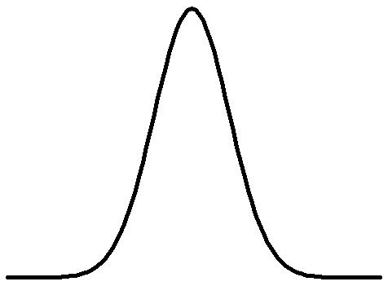
Business Problem
The increasing demand for energy is one of the biggest reasons behind the integration of solar energy into the electric grids or networks.
To ensure the efficient use of energy PV systems it becomes important to forecast information reliably.
The accurate prediction of solar power variation can enhance the quality of service. This integration of solar energy and accurate prediction can help in better planning and distribution of energy.
Solar Power data
Solar Plan power Prediction
Database to store data
Statistical Tools (Arima, STLF, ANN)

Slide 5
DATA PRE-PROCESSING
Data Pre-Processing
Dataset was been stored in the json file on various time windows into 5, 10, 15, 30 and 60 minutes.
This were extracted into 5 csv files with varying length.
The data was having some outliers at the end of each month were the power reading was very high when compared to the others.
The outliers were been replaced by near by value by just replacing the higher value with the preceding lower value.

Slide 6
Outlier value in various time windows
The outliers might have been included due to improper recording or miss typing due to which the statistical model gets affected a lot.
There are 5 html files for every time window depicting the power at various times.
5 Minutes
10 Minutes
15 Minutes
30 Minutes
60 Minutes

Slide 7
Demo graphs of the Final Data Frame
 | Total Observations | Total variables | Split Observations | Target Variable | Evaluation Metric
5 Minutes | 4620 | 2(Time and Target) | 3542-1078 | Units Produced | RMSE and MSE
10 Minutes | 2310 | 2(Time and Target) | 1771-539 | Units Produced | RMSE and MSE
15 Minutes | 1530 | 2(Time and Target) | 1173-357 | Units Produced | RMSE and MSE
30 Minutes | 750 | 2(Time and Target) | 575-175 | Units Produced | RMSE and MSE
60 Minutes | 360 | 2(Time and Target) | 276-84 | Units Produced | RMSE and MSE

Slide 8
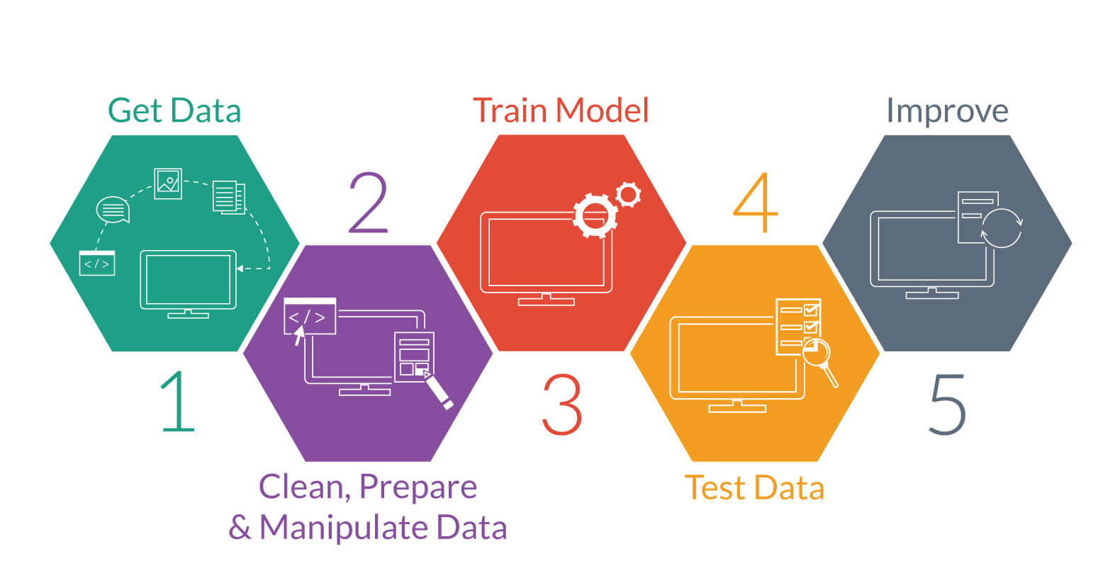
Model Building

Slide 9

Model Building approach
Solar Power Database
MODEL
Arima, Stlf, ANN
Units produced
0.2
Output
0.8
1.5
Input
Convert Into Csv Readable file
Predictions
Input
Date
Units produced
0.2
New Data
Time series Data
Date
0.8
1.5
Target Labels

Slide 10
Case 1: Using STLF Technique to Build the Model
If we want to predict the power for longer time horizon then we should go for higher time window zone when compared to others.
As the error in predicting the longer time zone is lesser when compared to lower time window.

Slide 11
Various Time Frame
From this plots we can say that 30 minutes time window is not appropriate for predicting the various time frame windows.
As the window Changes predicting with 30 mins window will be costly when comparing to others.

Slide 12
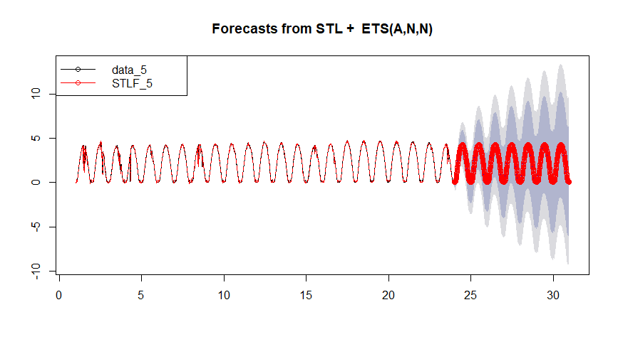
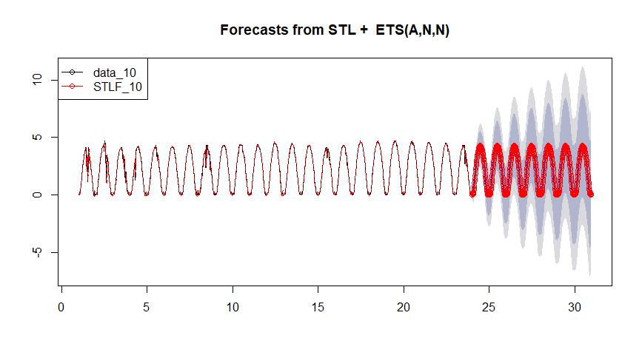
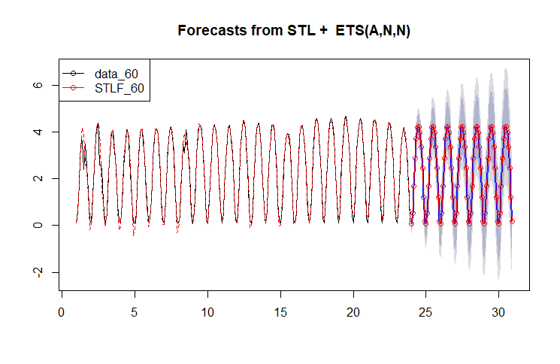
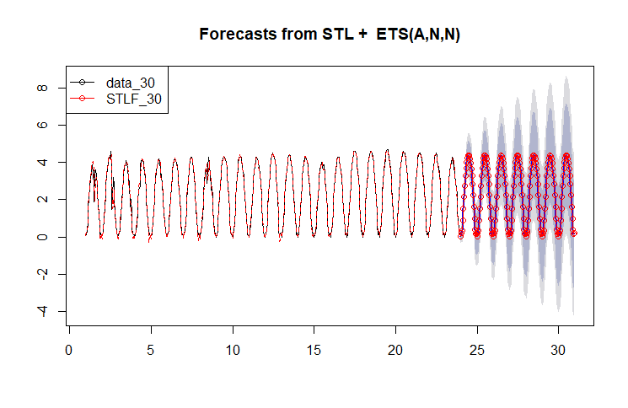
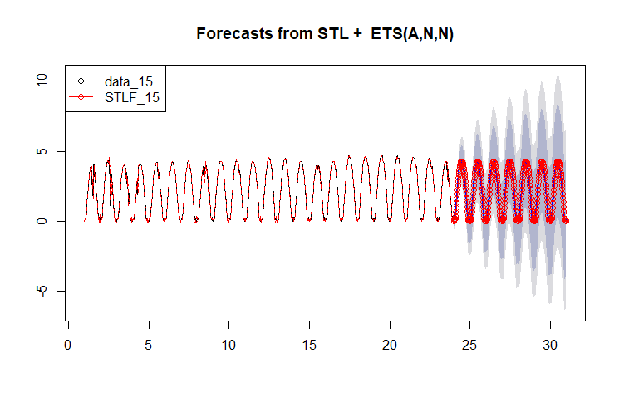
predictions

Slide 13
Case 2: Using Arima Technique to build the model
If we want to predict the power for longer time horizon then we should go for higher time window zone when compared to others.
As the error in predicting the longer time zone is lesser when compared to lower time window.

Slide 14
Various Time Frame
From this plots we can say that 30 minutes time window is not appropriate for predicting the various time frame windows.
As the window Changes predicting with 30 mins window will be costly when comparing to others.

Slide 15
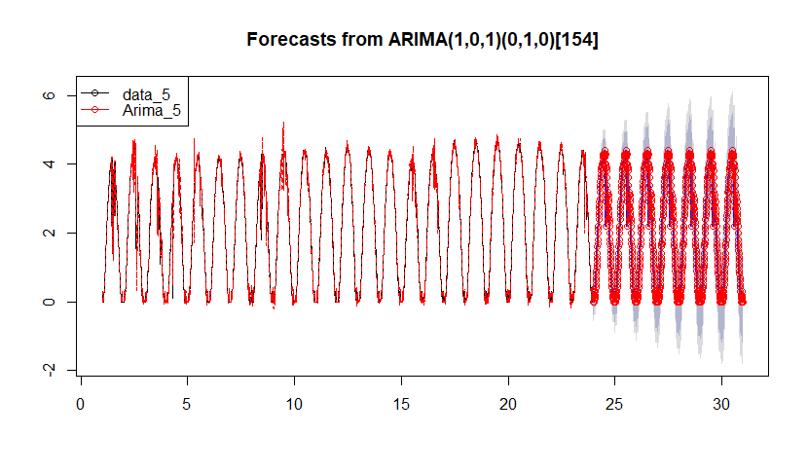
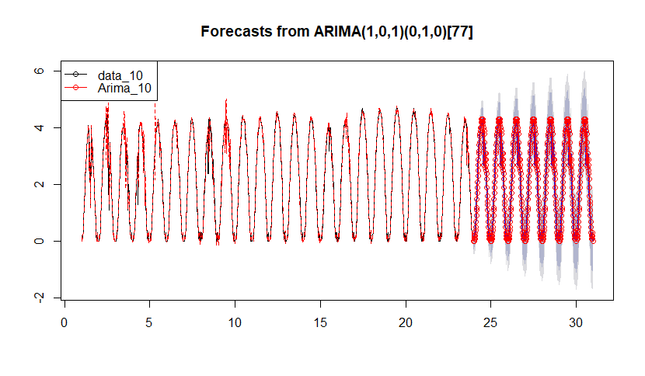
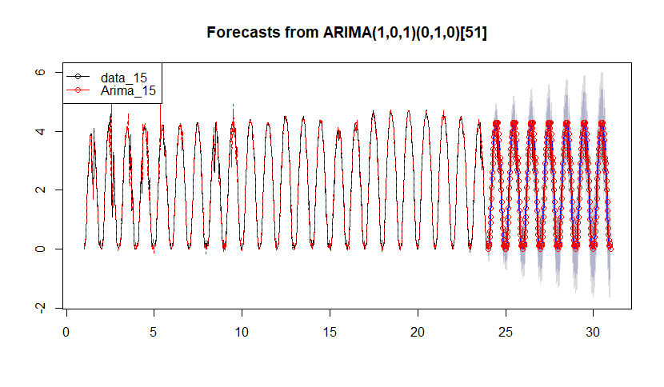
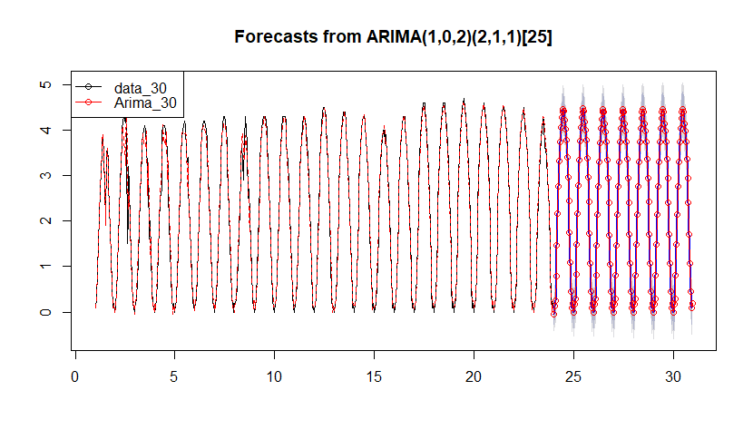
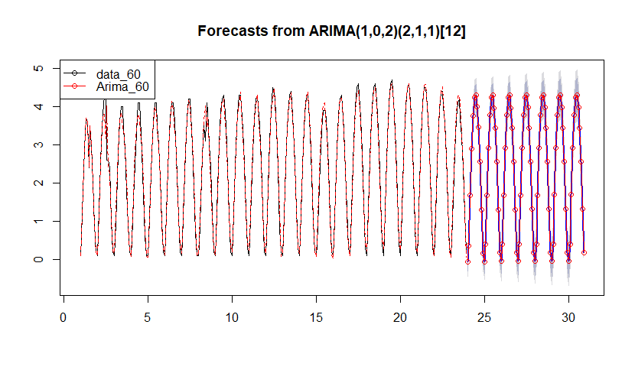
predictions

Slide 16
Case 3: Using NNET Technique to build the model
If we want to predict the power for longer time horizon then we should go for higher time window zone when compared to others.
As the error in predicting the longer time zone is lesser when compared to lower time window.

Slide 17
Various Time Frame
From this plots we can say that 30 minutes time window is not appropriate for predicting the various time frame windows.
As the window Changes predicting with 30 mins window will be costly when comparing to others.

Slide 18
Tools and Hyper parameters used in the model
STLF Model: The baseline package which was been used is forecast and no such tuning been done just the seasonality has been taken into account.
Arima Model: The baseline package which was been used is forecast and no such tuning been done just the seasonality has been taken into account.
Nnet Model: The baseline package which was been used is forecast and no such tuning been done just the seasonality has been taken into account.
Packages used are: Forecast, Lubridate, Ggplot, dygraphs, xts, and Tidy verse.
Tools Used: R for forecasting and model building, Python for data frame frame extraction from the file.

Slide 19
CONCLUSION
FINAL MODEL: Nnet
For Long run prediction with 60 Min time window we should use Nnet.

Slide 20
CONCLUSION
From the above data it is clear that time window 30 performance is not good when compared to others.
We should use Stlf for 1 Hour window prediction.
For 6 hours window we should go Arima as it is stable in all windows.
For more than 1 day we should go for Nnet as the error will be less.

Slide 21
THANK You

